Slide 1
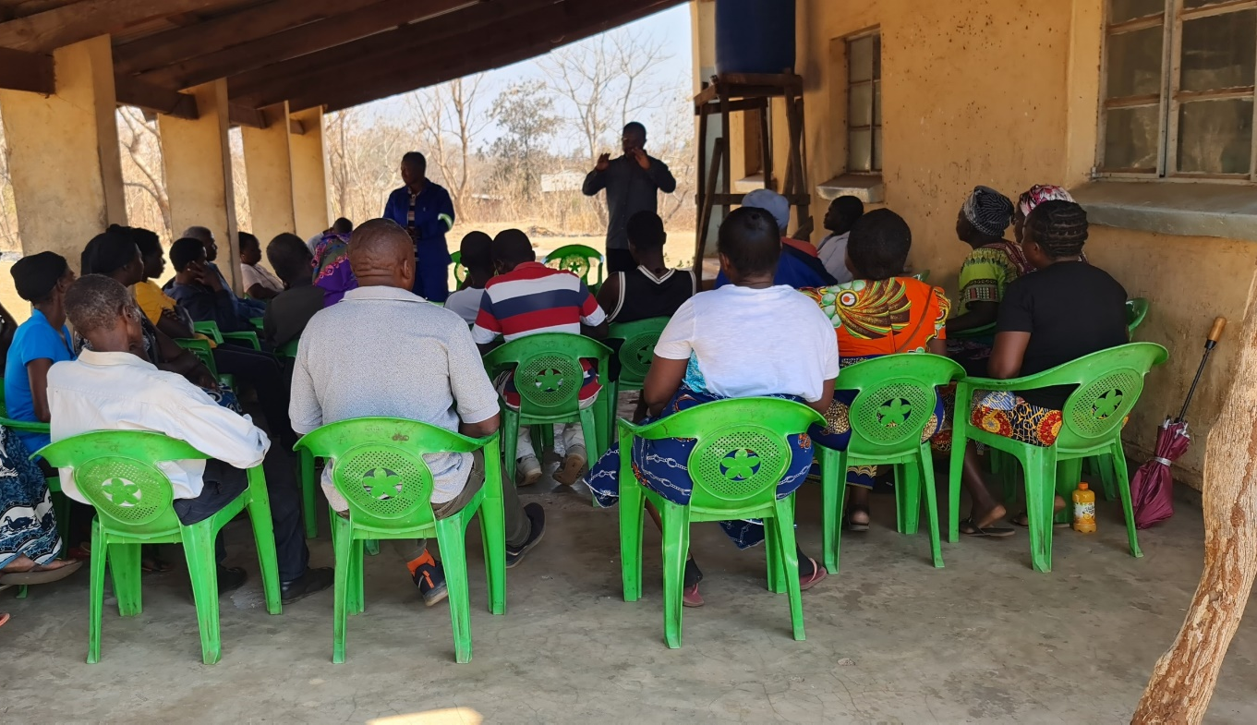
Image of farmer meetings by author

Slide 2
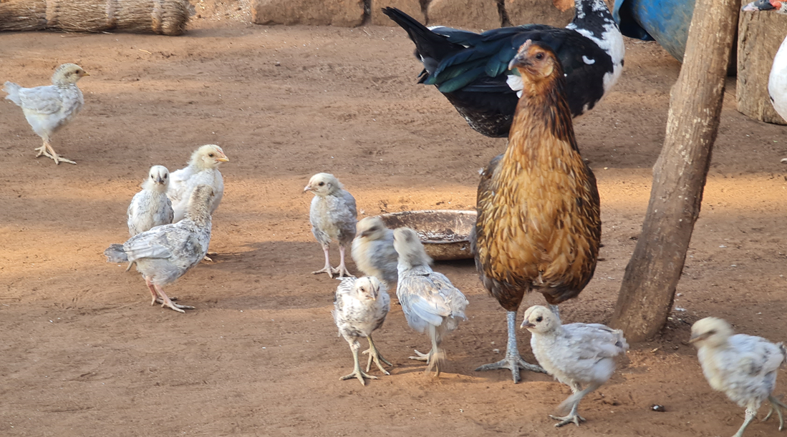
Indigenous hen and chicks photo by C.M Kanyama

Slide 3
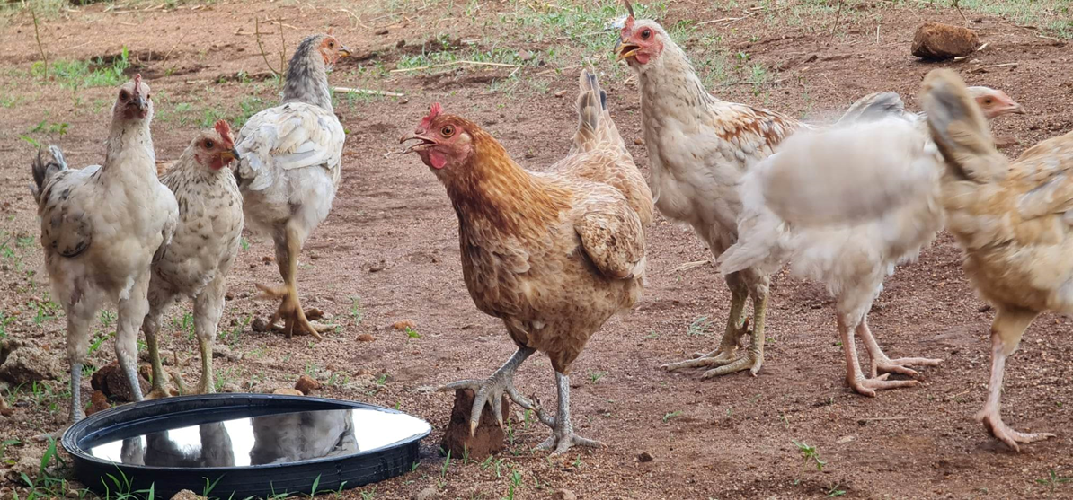
Small flock of indigenous chickens photo by C.M Kanyama

Slide 4
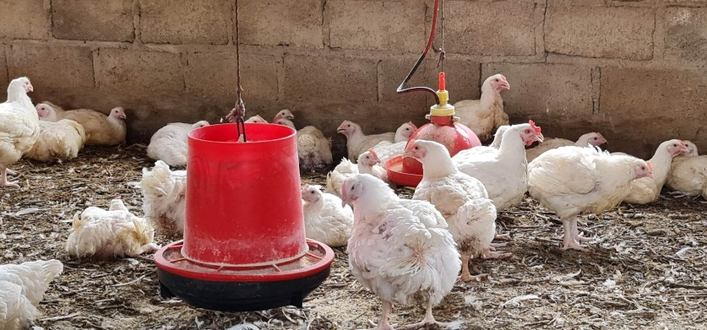
Small-scale broiler enterprise photo by C.M. Kanyama

Slide 5
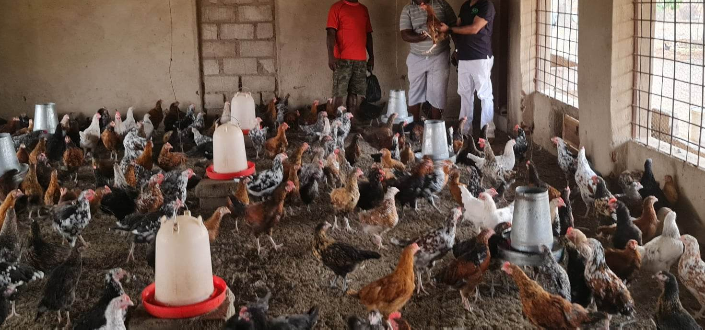
Indigenous chickens grown under intensive and semi-intensive systems photo by author

Slide 6
Carcasses of male and female indigenous chickens photo by C.M. Kanyama

