Slide 1
INCLUSIVE EDUCATION IN ILE’S
ILEs and the education of students with disabilities in Aotearoa
Angela Page – University of Newcastle, AU
Jennifer Charteris – University of New England, AU
Notes:
Even though we now both live in Australia, Jennifer and I grew up in New Zealand. We have extensive experience teaching in secondary schools, special education settings and working in the Ministry of Education.

Slide 2
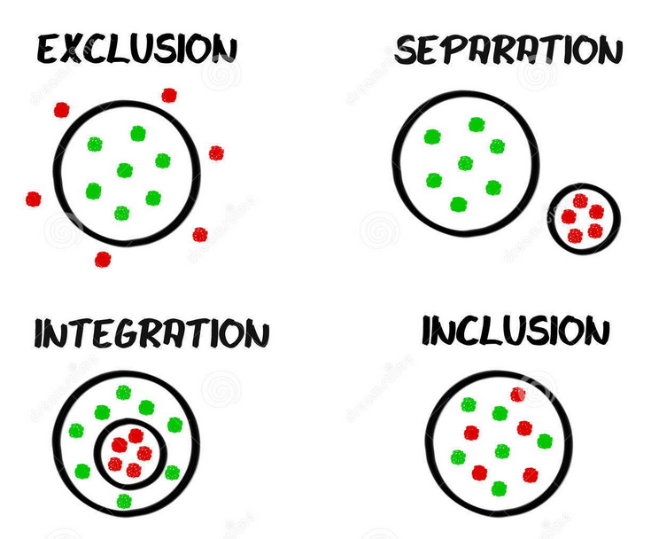
Different ways to interpret placement of students with special education needs
Australian context
New Zealand/Aotearoa context
Students with mild/ high level of disability
Students with very high level of disability
Notes:
Inclusion in Australia - An extensive review of the literature by Anderson, Boyle, Depperler (2014) found three consistent components of Inclusive Education: all students, regardless of circumstance, must be successfully participating, achieving and being valued within the regular classroom in their local school. This does not just refer to students with disability but refers to the education for all students. Each state however, interprets, practices and locates Inclusive Education differently.
Inclusion in NZ is similar to this view but is applied nationally rather than by each state – In New Zealand, the Ministry of Education states that Inclusive Education means all children and young people are engaged and achieve through being present, participating, learning and belonging. It means all learners are welcomed by their local early learning service and school, and are supported to play, learn, contribute and participate in all aspects of life at the school or service.
These definitions allow multiple meanings in looking at the concepts of inclusion –
We describe these various lenses of inclusion using Haug’s (2017) notion of vertical and horizontal alignment. Haug suggests that both vertical (between political and organisational aspects) and horizontal unity (definitions special school versus full inclusion) need to occur for inclusion to be successful. This is to say - policy and practice need to come together.
This slide shows:
Some students are enrolled in attached units and some are enrolled in segregated special school settings. Their participation in their school is not necessarily a result of their their level of disability although this is usually the defining characteristic. Parental choice may determine enrolment in one or the other setting.
Students with high levels of disability/ need are generally regarded to be able to cope with demands of mainstream education. In comparison, Students in Special schools have greater, or very high disability/ complex needs.

Slide 3
ILEs and Disability
Design fit for students with very high needs?
Notes:
Students in Special Schools exist as stand alone facilities but there is an interest in building Satellite units attached to ILE’s – this is important as it shifts students to a more visible and included education.
The interest in building Satellite units provides an opportunity to debate the purpose and the design of these buildings.
There is some research in the area of Special Schools and ILE’s.
There is also some research with ILE and disability. Eg break out spaces that you see here.
But there is little to inform the intersection of these practices coming together from the Special School into the Satellite unit space.
So we pose the question: how does the ILE design fit the needs of students with very high needs? How might students with any level of disability benefit from the ILE model?

Slide 4
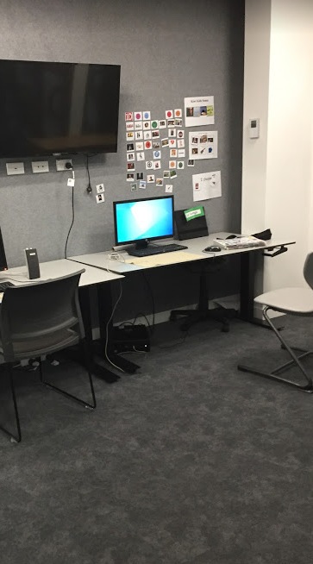
Special School
Reluctance
Notes:
We conducted qualitative interviews with Christchurch Special school, Satellite school and mainstream school staff who taught students with disabilities.
Three key points emerged. The first is:
There was a reluctance by special school staff to change from being a separate school and amalgamate within ILE settings. There was a perception that students needed the single cell environment and more specialized setting. There was a perception that break out spaces, for example, were not enough. Staff stated that some students need the antithesis of ILE design – dark colours such s grey and brown, low levels of light, creating quiet, reducing movement. Individual space was preferred for these students versus shared collaboration.
The reluctant staff did not see opportunities for pedagogical change or learning to be different. Status quo was supported.
The status quo supports specific spaces for each child, as you see here. This is not a shared space but meets the needs of an individual boy. He has his own chair, own visual schedule and support, own computer and tasks. Note the grey colours and low lighting.

Slide 5
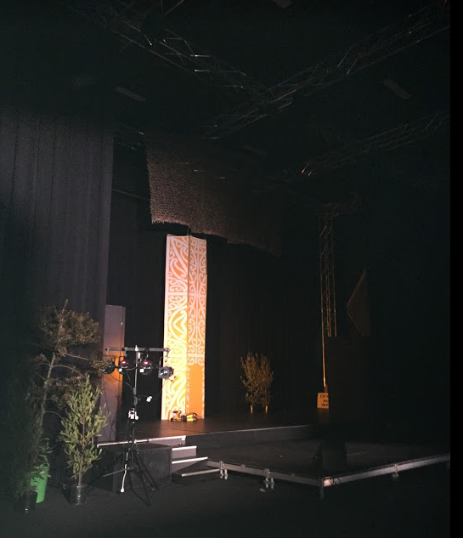
Benefits
Potential academic and behavioural benefits
Notes:
Second point:
That staff saw benefits for students with high needs in mainstream settings. Benefits included improved learning and behaviour. Students for example were able to design their own programme, and this participation and control over their learning maximized their engagement and experiences.
For example – this photograph was taken by a 16 year old girl diagnosed with Fetal Alcohol Syndrome.
She identified this place as something that she considered valuable – When she came to this school she could read at under 5 years and was not communicative. She came to this ILE as a mainstream student and thrived. She describes how she was able to make her own choices about her learning and was motivated by that. She also stated how she wanted to be involved in drama (room in picture) and she was supported to apply for the director job (supported by staff). Now she works on a unit standards literacy programme as she was motivated to learn to read to do this job better.

Slide 6
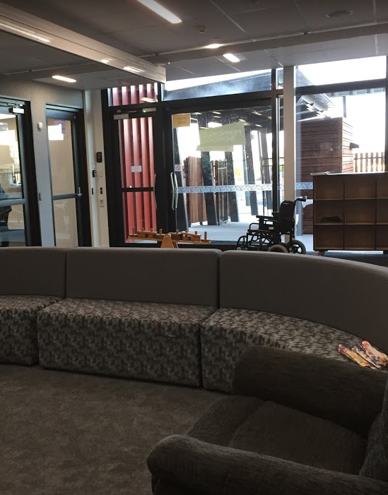
Satellite units
Social benefits
Notes:
Third point –
There were benefits for students enrolled in Satellite units if the staff were open to, and supportive of, the notion that ILEs could provide opportunities. These staff wanted more communication and flexibility to move between the spaces than currently existed. Closed doors and separate spaces still operating although Satellite teachers supportive and not supportive of ILEs could not see any positive opportunities other than increased social inclusion. However they already have opportunities for social inclusion under the old model.
The solid wall to the right of photo is where the mainstream school is. This unit had closed the connecting door and placed a physical barrier up to visually separate the two spaces. One student was participating socially with the others, and sometimes other students from mainstream interacted in a programme in this area. This arrangement of space and movement between the spaces was observed in other schools.

Slide 7
Flexible space?
Teaching and learning possibilities
Enhanced social possibilities
Notes:
Can we have more seamlessness? More movement between these spaces? Permeable membrane?

Slide 8
Possibilities
How can there be increased movement between spaces?
How can seamlessness be enhanced to support students with very high needs?
Possibilities for students and for further research
Notes:
Meeting individual needs in an ILE does not mean letting go of individual spaces, it means the provision of individual spaces that some students with and without disabilities will need for additional support. For students with a very high needs, the additional support will be at a level that movement between spaces is likely to be minimal. For other students, the possibilities are potentially greater.

