Slide 1
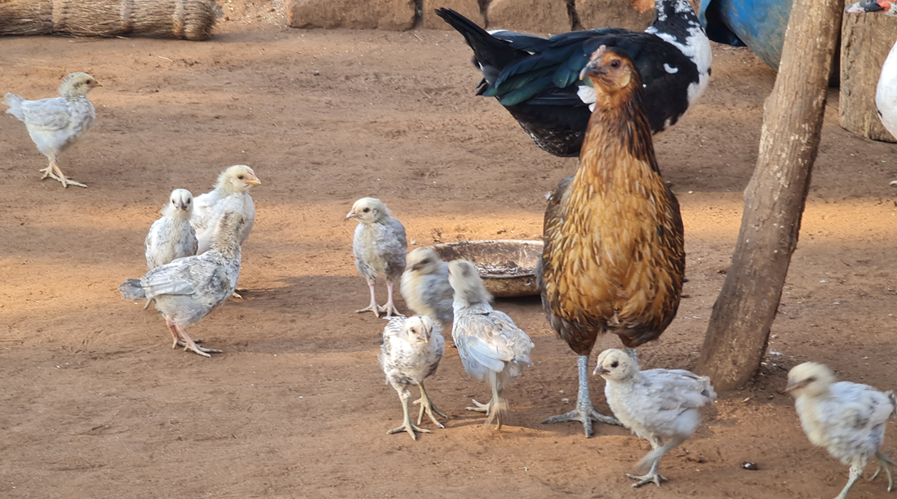
Indigenous chicken hen and chicks photo by C.M Kanyama

Slide 2
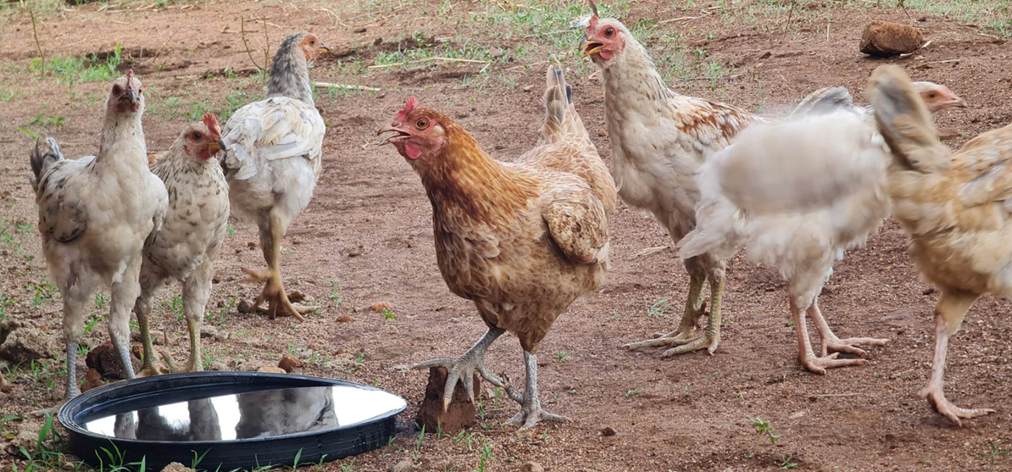
Small flock of indigenous chickens photo by C.M Kanyama

Slide 3
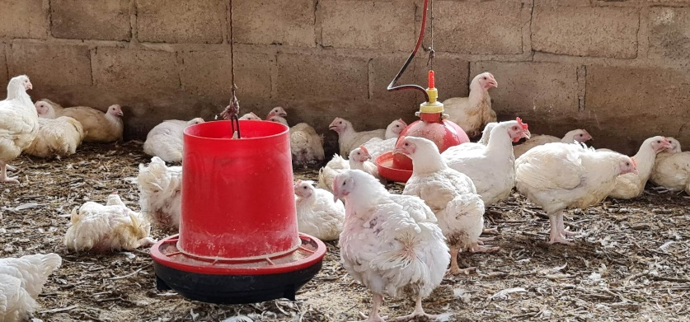
Small-scale broiler enterprise photo by C.M. Kanyama

Slide 4
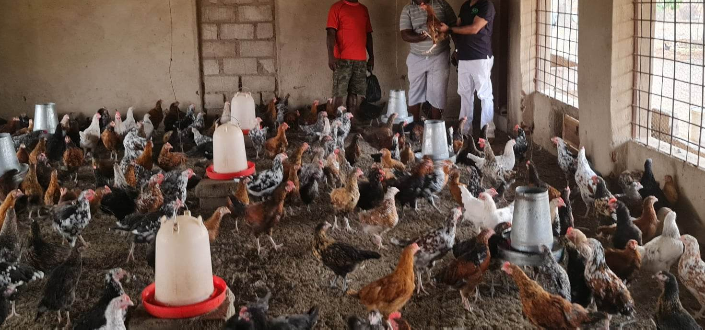
Chickens grown under intensive and semi-intensive systems photo by C.M Kanyama

Slide 5
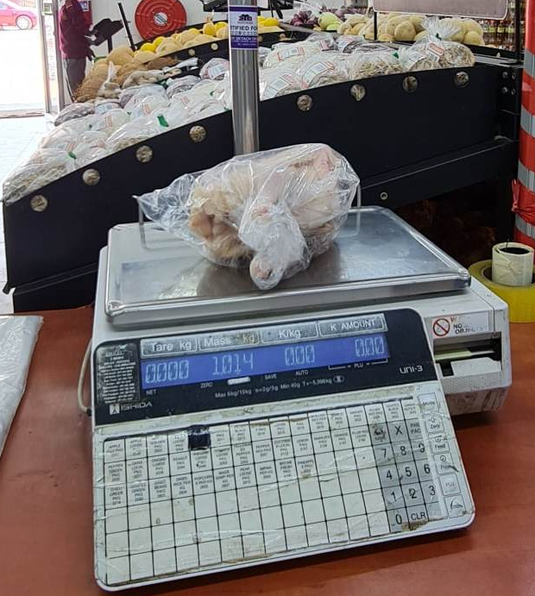
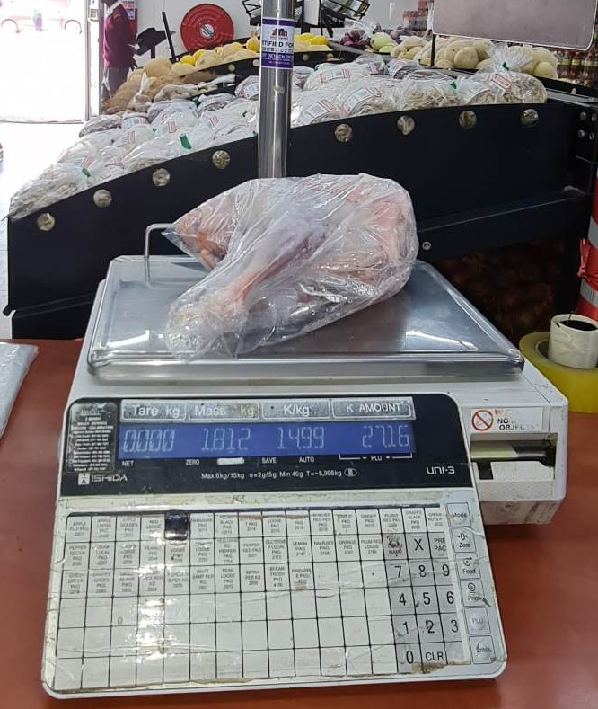
Hen’s Carcass
Cockerels’ Carcass
Whole Carcasses for indigenous chickens photo by C.M. Kanyama

Slide 6
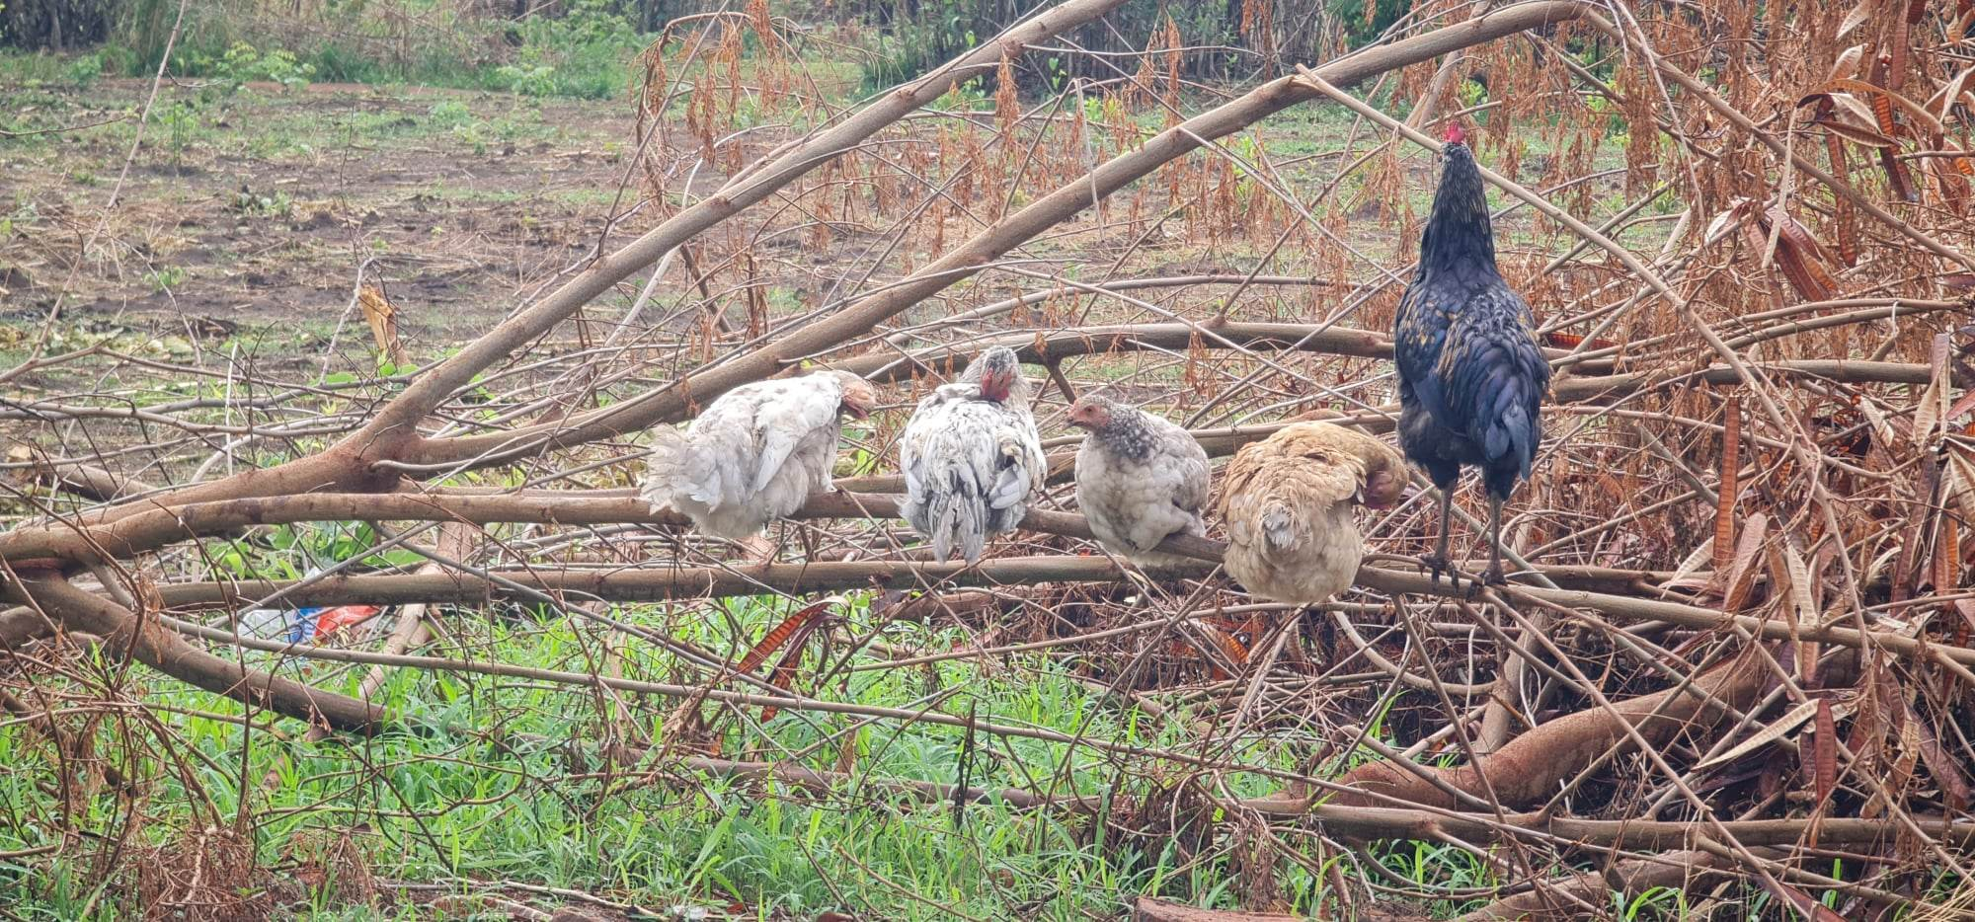
Indigenous chickens raised in a free-range system by small-scale farmers photo by C.M. Kanyama

Slide 7
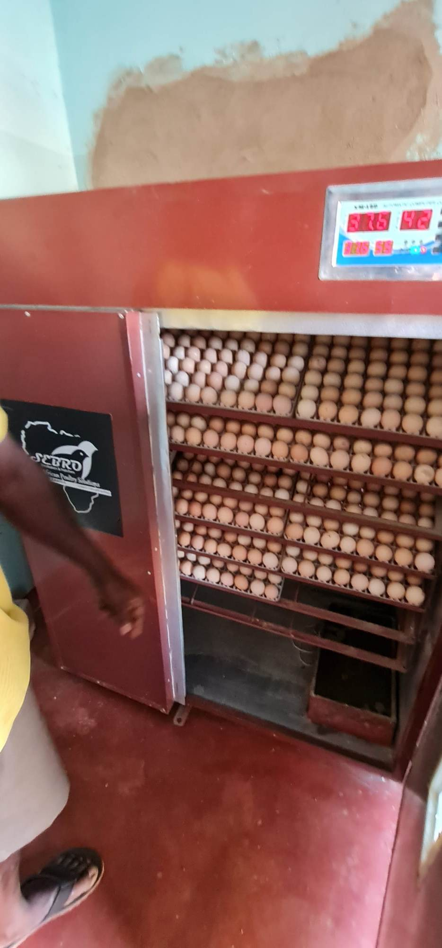
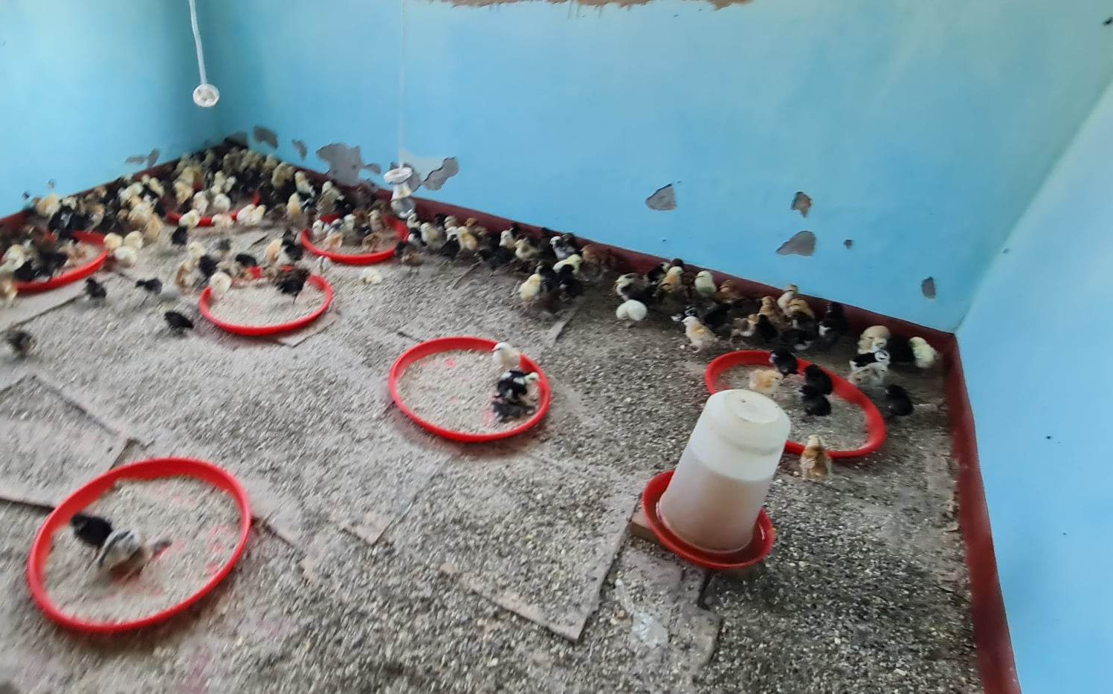
Chick Brooding
Egg Incubation
Semi-improved system by small-scale farmers photo by C.M. Kanyama

Slide 8
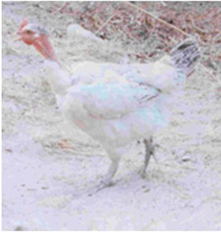
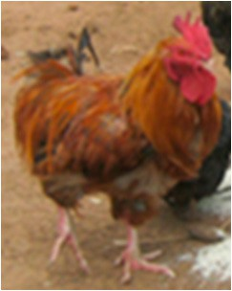
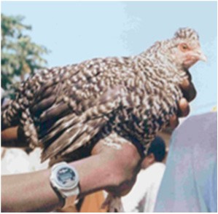
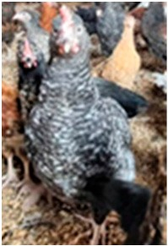
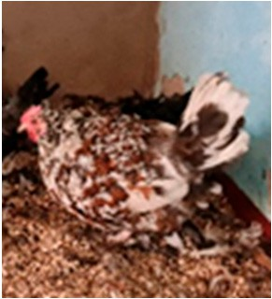
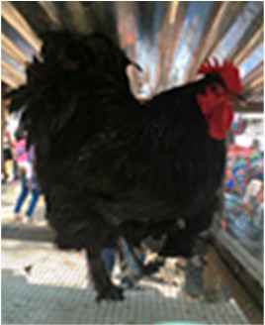
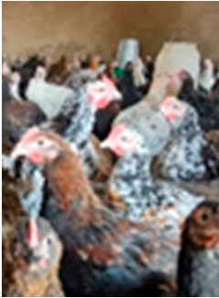
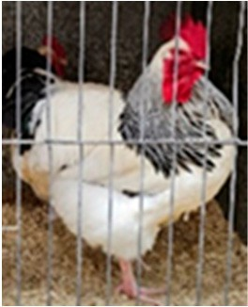
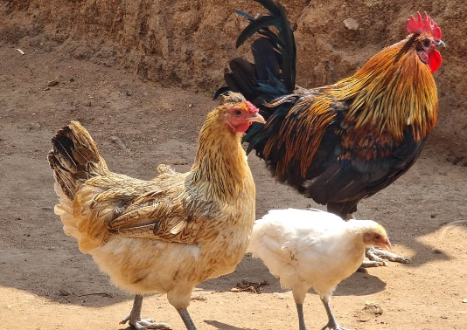
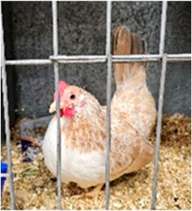
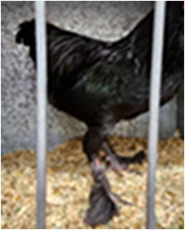
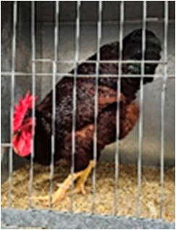
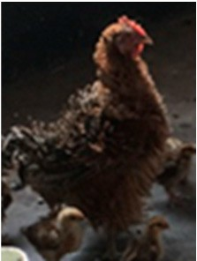
Naked Neck
Short-Legged
Crested
Barred-Feathered
Boschvelds
Black Australorps
Kruoillers
Sussex
Common Zambi
Dwarf
Feathered-Shanks
Rhode Island Red
Frizzled-Feathered
Some common chicken breeds reared by small-scale farmers in Zambia photos by C.M. Kanyama

